Slide 1
Solving a problem with Hill climbing algorithm
Presenter: Iliasov Usonbek
Supervisor: Bencsik Gergely

Slide 2
Introduction
Hill climbing, an uncomplicated optimization technique in Artificial Intelligence (AI), is employed to discover the most optimal solution for a specific problem. Belonging to the category of local search algorithms, it is commonly applied in optimization problems with the aim of determining the finest solution from a collection of potential solutions. Here we’ll talk about:
Advantages of Hill Climbing algorithm:
Disadvantages of Hill Climbing algorithm:
Heuristic Search
Features of Hill Climbing

Slide 3
Advantages of Hill Climbing algorithm:
Hill Climbing demonstrates high efficiency in identifying local optima, rendering it a favorable option for expeditiously resolving issues.
Hill Climbing is a straightforward and user-friendly algorithm that is both comprehensible and easy to put into practice.
Its applications extend to a diverse range of optimization problems, encompassing those characterized by extensive search areas and intricate limitations.

Slide 4
Disadvantages of Hill Climbing algorithm:
Hill Climbing can get stuck in local optima, meaning that it may not find the global optimum of the problem.
The algorithm is sensitive to the choice of initial solution, and a poor initial solution may result in a poor final solution.
Hill Climbing does not explore the search space very thoroughly, which can limit its ability to find better solutions.

Slide 5
Heuristic search
Hill Climbing is a heuristic search used for mathematical optimization problems in the field of Artificial Intelligence.
Given a large set of inputs and a good heuristic function, it tries to find a sufficiently good solution to the problem. This solution may not be the global optimal maximum.

Slide 6
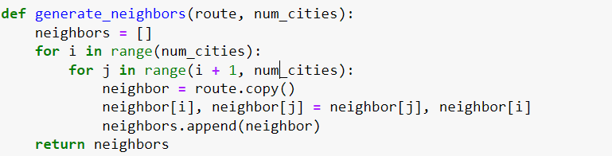


Slide 7
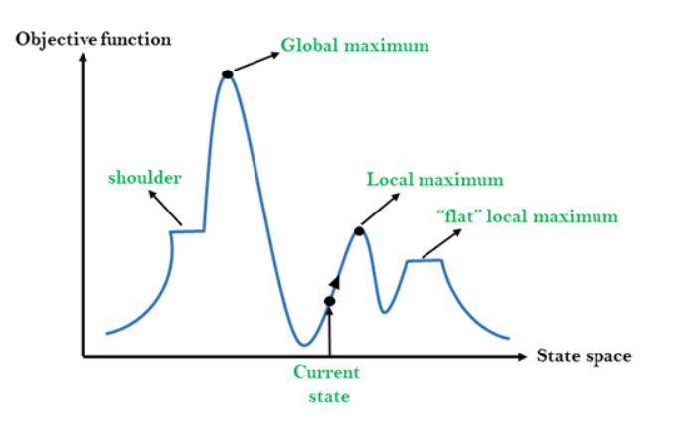
Features of Hill Climbing Algorithm
Generate and Test variant: Hill Climbing is the variant of Generate and Test method. The Generate and Test method produce feedback which helps to decide which direction to move in the search space.
Greedy approach: Hill-climbing algorithm search moves in the direction which optimizes the cost.
No backtracking: It does not backtrack the search space, as it does not remember the previous states.

Slide 8
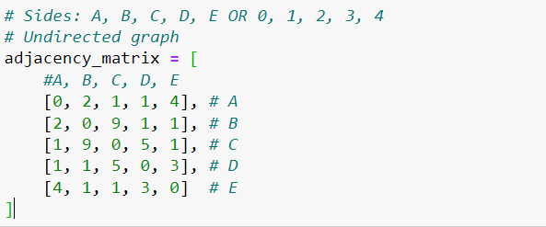
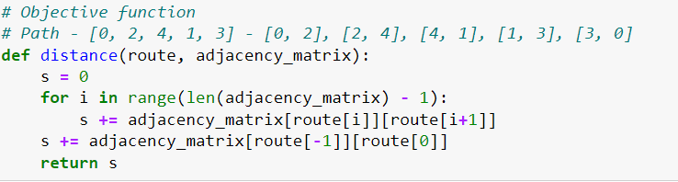

Slide 9
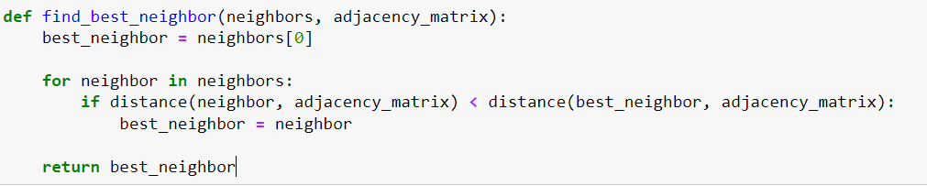
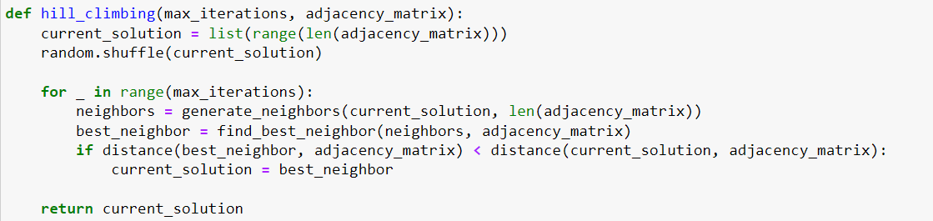

Slide 10
Thanks for your attention

